Slide 1
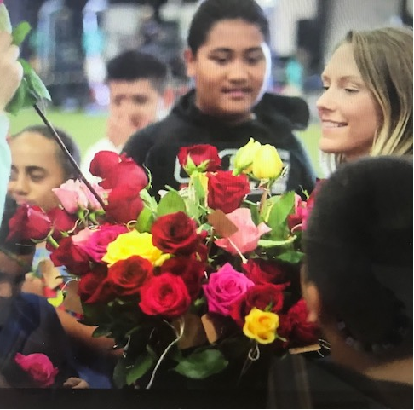
Megan Kirtland Food-obsessed, experience-driven Kansas native and Texas transplant. And tacos. Because they deserve their own callout. |  | Superpower: Decoding and applying insights from emotional information to guide thinking and behavior – at home, in the Board Room and beyond. Most-admired quality: Being a do-er. Which usually inherently means being a problem-solver and many times, an optimist! I also smile a lot. Some people like it, some people are creeped out by it.
 | Basic Demographics | Part German, part Scandinavian. Ratio unknown. But white. 27 years young. Ignore what the grey hair tells you. From Overland Park, KS which = Kansas City Chiefs and KC Royals fan (but admittedly the most fair weather fan ever)
 | Lifestyle/Activities | Traveling without an itinerary Following the best food and the best people will always put you in the best places – in the company of those that will change your world and the world around them Healthy-living, including nutrition, semi-athletic activity, and researching how we can all improve our own well-being M&A professional serving high tech companies
I am 5’ 11’’ and love being tall! I wish more young women embraced their height. It is one of the greatest gifts you can be given as a female, especially in the workplace! | Passions: I love | Love Non-profit youth development with a particular focus in, you guessed it, food and culinary education! Hygge core Danish philosophies and its application to building warm, welcoming environments Being present in each moment Decisiveness Research on biohacking

